Slide 1


Slide 2

Raise your hand if…
you have ever read an entire poem only to realize that you have absolutely no clue what you just read.

Slide 3

It happens…
STOP WASTING TIME WITH MINDLESS READING!
Annotating poems will help you remember, understand, and
connect with the poem.

Slide 4

What is Annotating?
Annotation is the ACT of making a note in ANY form while reading

Slide 5

Annotation is NOT…
Highlighting without a purpose
Underlining or highlighting the majority of the text
Drawing symbols without writing notes

Slide 6

Why Do We Annotate?
The majority of reading is just skimming, this is NOT helpful when reading for understanding.
Annotating a Text:
slows the reader down
promotes active reading
improves reading and writing
allows the reader to make connections

Slide 7

What Will I Need?
Annotation tools:
Pencil
Colored pens (optional)
Highlighter (optional)
Post-it notes (optional)
Annotation Guide
Your own copy of the poem!

Slide 8
Annotation Guide
Symbol | Guide
Identify | The rhyme scheme of the poem
Count | The number of stanzas in the entire poem and the number of syllables in each line.
Underline | Words or phrases you do not know or understand.
Squiggle Line | All sound devices (alliteration, assonance, consonance)
Star | Place a star next to figurative language
Box | Draw a box around words that depict a setting
Highlight | Repeated words or phrases
Circle | Emotionally charged words
WRITE | Write important thoughts and connection in the margins

Slide 9
Annotation Guide
Symbol | Guide
Identify | Write capital letters (A, B, C, etc.) next to each line
Count | Write the number and circle it next to each stanza/line
Underline | Look up the meaning of the word or phrase and write it in the margin
Squiggle Line | Write which type of sound device the poet used. Add notes to the margin about how it enhances the meter of the poem
Star | Write which kind of figurative language it is that you identified. Add a note in the margin explaining its meaning and significance
Box | Really try to picture the scene
Highlight | Write a note in the margin about the significance of repetition of the word or phrase
Circle | These are words that will help reveal the poem’s tone. Write a note about why that word is emotionally charged in the margin
WRITE | Write any thoughts or ideas you have while reading

Slide 10
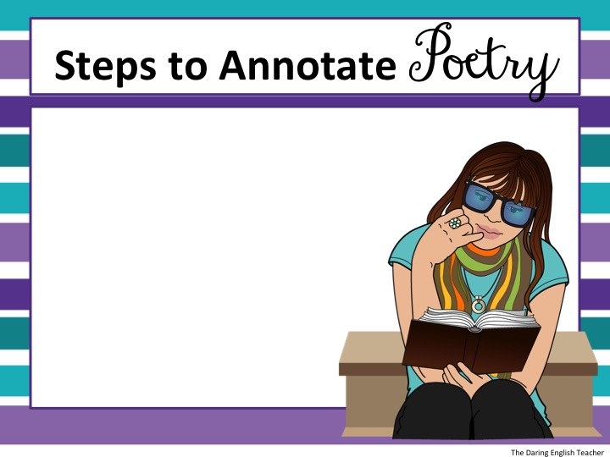

1. Read the entire poem.
Don’t worry about
understanding the
poem just yet.
Just read it!

Slide 11
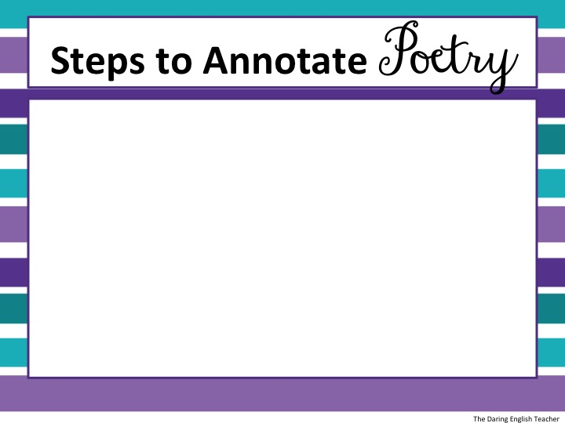
2. Analyze and annotate the poem’s organization.
How many stanzas are there?
What is the rhyme scheme?
How many syllables are in each line?
Write this information down!

Slide 12
3. Reread the poem and underline and define words your don’t know.
Write the meaning of the words and phrases in the margins.
Check to make sure an unknown phrase isn’t figurative language.

Slide 13
4. Reread the poem and make detailed annotations. Look for:
Repetition (highlight repeated words/phrases)
Star and explain figurative language
Squiggle line all sound devices
Box words that paint a vivid picture (imagery)

Slide 14
5. Question the poem.
What is the author saying?
What is the author’s tone?
What is the author’s style?
How does this poem make me feel?

Slide 15
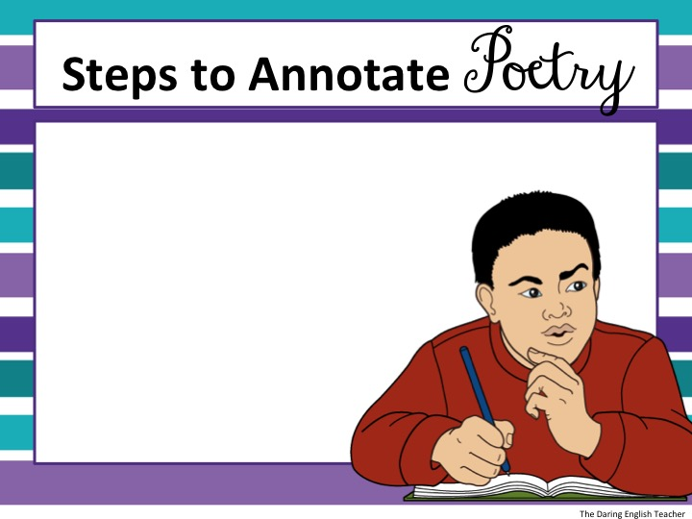
6. Review your annotations. Look for a deeper meaning.

Slide 16
Steps to Annotate Poetry
7. Identify and explore the poem’s theme.
The theme is the central message of the poem.

Slide 17
Practice
“I Wandered Lonely as a Cloud”
By: William Wordsworth
Use the symbols from the previous slide to annotate William Wordsworth’s poem “I Wandered Lonely as a Cloud.”
I wandered lonely as a cloud
That floats on high o'er vales and hills,
When all at once I saw a crowd,
A host, of golden daffodils;
Beside the lake, beneath the trees,
Fluttering and dancing in the breeze.
Continuous as the stars that shine
And twinkle on the milky way,
They stretched in never-ending line
Along the margin of a bay:
Ten thousand saw I at a glance,
Tossing their heads in sprightly dance.
The waves beside them danced; but they
Out-did the sparkling waves in glee:
A poet could not but be gay,
In such a jocund company:
I gazed—and gazed—but little thought
What wealth the show to me had brought:
For oft, when on my couch I lie
In vacant or in pensive mood,
They flash upon that inward eye
Which is the bliss of solitude;
And then my heart with pleasure fills,
And dances with the daffodils.

Slide 18
Practice
“I Wandered Lonely as a Cloud”
By: William Wordsworth
Step 1: Read the Text
I wandered lonely as a cloud
That floats on high o'er vales and hills,
When all at once I saw a crowd,
A host, of golden daffodils;
Beside the lake, beneath the trees,
Fluttering and dancing in the breeze.
Continuous as the stars that shine
And twinkle on the milky way,
They stretched in never-ending line
Along the margin of a bay:
Ten thousand saw I at a glance,
Tossing their heads in sprightly dance.
The waves beside them danced; but they
Out-did the sparkling waves in glee:
A poet could not but be gay,
In such a jocund company:
I gazed—and gazed—but little thought
What wealth the show to me had brought:
For oft, when on my couch I lie
In vacant or in pensive mood,
They flash upon that inward eye
Which is the bliss of solitude;
And then my heart with pleasure fills,
And dances with the daffodils.

Slide 19
Practice
How many stanzas are there?
What is the rhyme scheme?
“I Wandered Lonely as a Cloud”
By: William Wordsworth
Step 2: Analyze and annotate the poem’s organization
I wandered lonely as a cloud
That floats on high o'er vales and hills,
When all at once I saw a crowd,
A host, of golden daffodils;
Beside the lake, beneath the trees,
Fluttering and dancing in the breeze.
Continuous as the stars that shine
And twinkle on the milky way,
They stretched in never-ending line
Along the margin of a bay:
Ten thousand saw I at a glance,
Tossing their heads in sprightly dance.
E
G
E
G
H
H
A
B
A
B
C
C
The waves beside them danced; but they
Out-did the sparkling waves in glee:
A poet could not but be gay,
In such a jocund company:
I gazed—and gazed—but little thought
What wealth the show to me had brought:
For oft, when on my couch I lie
In vacant or in pensive mood,
They flash upon that inward eye
Which is the bliss of solitude;
And then my heart with pleasure fills,
And dances with the daffodils.
Each stanza has the same rhyme scheme: A B A B C C
1
3
D
E
D
E
F
F
4
2
I
J
I
J
B
B

Slide 20
Practice
Practice
“I Wandered Lonely as a Cloud”
By: William Wordsworth
Step 3: Underline and define words you don’t know.
I wandered lonely as a cloud
That floats on high o'er vales and hills,
When all at once I saw a crowd,
A host, of golden daffodils;
Beside the lake, beneath the trees,
Fluttering and dancing in the breeze.
Continuous as the stars that shine
And twinkle on the milky way,
They stretched in never-ending line
Along the margin of a bay:
Ten thousand saw I at a glance,
Tossing their heads in sprightly dance.
E
G
E
G
H
H
A
B
A
B
C
C
The waves beside them danced; but they
Out-did the sparkling waves in glee:
A poet could not but be gay,
In such a jocund company:
I gazed—and gazed—but little thought
What wealth the show to me had brought:
For oft, when on my couch I lie
In vacant or in pensive mood,
They flash upon that inward eye
Which is the bliss of solitude;
And then my heart with pleasure fills,
And dances with the daffodils.
1
3
Cheerful and lighthearted
D
E
D
E
F
F
4
2
I
J
I
J
B
B
Engaged in deep thought

Slide 21
Practice
Practice
“I Wandered Lonely as a Cloud”
By: William Wordsworth
Step 4: Reread the poem and make detailed annotations.
I wandered lonely as a cloud
That floats on high o'er vales and hills,
When all at once I saw a crowd,
A host, of golden daffodils;
Beside the lake, beneath the trees,
Fluttering and dancing in the breeze.
Continuous as the stars that shine
And twinkle on the milky way,
They stretched in never-ending line
Along the margin of a bay:
Ten thousand saw I at a glance,
Tossing their heads in sprightly dance.
E
G
E
G
H
H
A
B
A
B
C
C
The waves beside them danced; but they
Out-did the sparkling waves in glee:
A poet could not but be gay,
In such a jocund company:
I gazed—and gazed—but little thought
What wealth the show to me had brought:
For oft, when on my couch I lie
In vacant or in pensive mood,
They flash upon that inward eye
Which is the bliss of solitude;
And then my heart with pleasure fills,
And dances with the daffodils.
1
3
Cheerful and lighthearted
D
E
D
E
F
F
4
2
I
J
I
J
B
B
Engaged in deep thought

Slide 22
Practice
Practice
“I Wandered Lonely as a Cloud”
By: William Wordsworth
Step 4: Reread the poem and make detailed annotations.
Let’s look at just one stanza at a time.

Slide 23
Practice
Practice
“I Wandered Lonely as a Cloud”
By: William Wordsworth
Step 4: Reread the poem and make detailed annotations.
Refer to your annotation guide.
I wandered lonely as a cloud
That floats on high o'er vales and hills,
When all at once I saw a crowd,
A host, of golden daffodils;
Beside the lake, beneath the trees,
Fluttering and dancing in the breeze.
Simile: Comparing the speaker’s solitude to a cloud.
Emotionally charged word with a negative connotation
Metaphor: Referring to the daffodils as a crowd.
Alliteration
Couplet
Personification: Daffodils are dancing, a human trait.

Slide 24
Practice
Practice
“I Wandered Lonely as a Cloud”
By: William Wordsworth
Step 4: Reread the poem and make detailed annotations.
Refer to your annotation guide.
Continuous as the stars that shine
And twinkle on the milky way,
They stretched in never-ending line
Along the margin of a bay:
Ten thousand saw I at a glance,
Tossing their heads in sprightly dance.
Simile: Comparing the daffodils to the stars and Milky Way
Hyperbole: Exaggeration of the line’s length
Hyperbole: Exaggeration of quantity
Couplet
Personification: Giving human characteristics to the daffodils. Humans toss their heads and dance merrily when they are happy and cheerful

Slide 25
Practice
Practice
“I Wandered Lonely as a Cloud”
By: William Wordsworth
Step 4: Reread the poem and make detailed annotations.
Refer to your annotation guide.
The waves beside them danced; but they
Out-did the sparkling waves in glee:
A poet could not but be gay,
In such a jocund company:
I gazed—and gazed—but little thought
What wealth the show to me had brought:
Personification: Waves cannot dance.
Emotionally charged word meaning happy
Cheerful and lighthearted
At the present time, he did not realize what joy the daffodils brought him
Couplet
Anastrophe: Inversion of the words

Slide 26
Practice
Practice
“I Wandered Lonely as a Cloud”
By: William Wordsworth
Step 4: Reread the poem and make detailed annotations.
Refer to your annotation guide.
For oft, when on my couch I lie
In vacant or in pensive mood,
They flash upon that inward eye
Which is the bliss of solitude;
And then my heart with pleasure fills,
And dances with the daffodils.
For oft = often
Anastrophe: Inversion of the words
Engaged in deep thought
When he is in a serious mood…
…he thinks of these daffodils...
Emotionally charged words with with positive connotations
Anastrophe: Inversion of the words
Couplet
… and they bring him pleasure and joy!

Slide 27
Practice
“I Wandered Lonely as a Cloud”
By: William Wordsworth
Step 5: Question the poem.
What is the author saying?
What is the author’s tone?
What is the author’s style?
How does this poem make me feel?
The author is saying that he one time walked alone. During his walk, he noticed a field of daffodils next to a body of water. There were many daffodils, and while it was a happy sight, he did not know the pleasure that they would ultimately bring him. Often times when he is sitting on his couch alone, he will think of those daffodils and that makes him happy.

Slide 28
Practice
“I Wandered Lonely as a Cloud”
By: William Wordsworth
Step 5: Question the poem.
What is the author saying?
What is the author’s tone?
What is the author’s style?
How does this poem make me feel?
The author’s tone is optimistic, happy, and upbeat. He is reflecting on a time that brought him great joy. This happy and optimistic tone is noted and recognized in words such as “sprightly,” “pleasure,” “jocund,” “fluttering,” “danced,” and “sparkling.”

Slide 29
Practice
“I Wandered Lonely as a Cloud”
By: William Wordsworth
Step 5: Question the poem.
What is the author saying?
What is the author’s tone?
What is the author’s style?
How does this poem make me feel?
The author wrote this poem in iambic tetrameter with couplets completing each stanza. The poem’s meter is upbeat and cheerful, which matches the poem’s tone.

Slide 30
Practice
“I Wandered Lonely as a Cloud”
By: William Wordsworth
Step 5: Question the poem.
What is the author saying?
What is the author’s tone?
What is the author’s style?
How does this poem make me feel?
This question is up to YOU to answer! How does it make you feel? This is the mood of the poem.

Slide 31
Practice
“I Wandered Lonely as a Cloud”
By: William Wordsworth
Step 6: Review Your Annotations
Step 7: Explore the poem’s theme
I wandered lonely as a cloud
That floats on high o'er vales and hills,
When all at once I saw a crowd,
A host, of golden daffodils;
Beside the lake, beneath the trees,
Fluttering and dancing in the breeze.
Continuous as the stars that shine
And twinkle on the milky way,
They stretched in never-ending line
Along the margin of a bay:
Ten thousand saw I at a glance,
Tossing their heads in sprightly dance.
The waves beside them danced; but they
Out-did the sparkling waves in glee:
A poet could not but be gay,
In such a jocund company:
I gazed—and gazed—but little thought
What wealth the show to me had brought:
For oft, when on my couch I lie
In vacant or in pensive mood,
They flash upon that inward eye
Which is the bliss of solitude;
And then my heart with pleasure fills,
And dances with the daffodils.
There are a couple themes to this poem. One theme could be interpreted as ‘nature makes people happy.’ Another theme is that ‘we often fail to appreciate the true beauty of nature.’ A final theme in the poem could be ‘unplugging from modern technology and connecting with nature makes us happy.’

